Slide 1
Chapter 2
PSYCHOLOGICAL RESEARCH

Slide 2
Psychological Research (1)
What does it mean “to research” something?
Why is research important?
Notes:
At one time in history, people believed the earth was flat and that mental illnesses were caused by possession.
People can be very wrong in their ideas about the world when they do not rely on evidence to support their claims.
Research is a mandatory process in validating claims.

Slide 3
Psychological Research (2)
Scientific research is empirical
  Grounded in objective, tangible evidence
  Can be observed multiple times, regardless of who is observing.
Without research, we would only have intuition and groundless assumptions.

Slide 4
Psychological Research (3)
Psychology is a science!
  Research is required to investigate, verify and support findings.
What does it mean for something to be a science?
Notes:
Through research we are able to prove certain ideas through study and testing.
Psychology is a science, therefore, research is required to not only further investigate something but provide verification and support of the findings.

Slide 5



The Scientific Approach (1)
Science is a method, not a topic
Emphasis on HOW something is studied, not what is studied

Slide 6
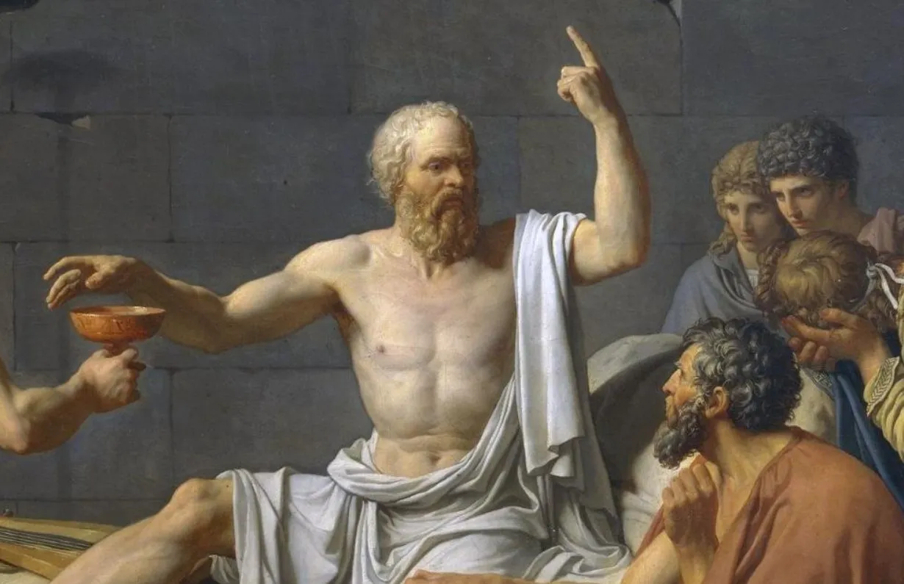
The Scientific Approach (2)
All scientists use the empirical method
  Empirical Method == Using observation or experiments to reach a conclusion.
  Opposite of speculative or exclusively reason-based approaches (like philosophy)

Slide 7
The Scientific Approach (3)
Psychology is a science. That means psychology is empirical!
The 3 goals of Psychology as a discipline include:
  1. Measurement and description
  2. Understanding and prediction
  3. Application and control

Slide 8
Two Types of Research (1)
Basic: Research that answers fundamental questions about phenomena

Slide 9
Two Types of Research (2)
Basic: Research that answers fundamental questions about phenomena
Applied: Research that investigates issues that have direct implications for a specific problem

Slide 10
Two Types of Research (3)
BASIC or APPLIED?
  A study into the different kinds of motivation?
    Basic! Why?
  Developing a program to improve children’s reading scores?
    Applied! Why?
  Researching different types of memory strategies?
    Basic (but maybe both?)

Slide 11

INDUCTIVE VS DEDUCTIVE REASONING (1)
Deductive reasoning - results are predicted based on a general premise.
All living things require energy to survive (premise), ducks are living things, therefore ducks require energy to survive (conclusion).
Inductive reasoning - conclusions are drawn from observations.
You see many fruit growing on trees and therefore assume all fruit grows on trees.

Slide 12
INDUCTIVE VS DEDUCTIVE REASONING (2)
Scientists form ideas (theories/hypotheses) through deductive reasoning.
Hypotheses are then tested through empirical observations and scientists form conclusions through inductive reasoning.
These conclusions lead to new theories and hypotheses (or more broad generalizations).

Slide 13
The Scientific Method – 5 General Steps
Observe
Hypothesize
Test
Conclusions
Evaluate

Slide 14

FALSIFIABLE HYPOTHESES
Many of the specifics of (a) Freud's theories, such as (b) his division of the mind into id, ego, and superego, have fallen out of favor in recent decades because they are not falsifiable.
However, his views set the stage for much of psychological thinking today, such as the unconscious nature of the majority of psychological processes.

Slide 15
Theory vs. Hypothesis
A scientific theory is a set of principles or claims intended to offer some description or explanation of a phenomenon
A testable prediction derived from a theory
Examples?

Slide 16
APPROACHES TO RESEARCH
Clinical or case studies
Naturalistic Observation
Surveys
Longitudinal and Cross-Sectional Research

Slide 17

CASE STUDIES
Case Studies focus on one individual (or small group)
The studied individual is typically in an extreme or unique psychological circumstance that differentiates them for the general public.
Allows for a lot of insight into a case.
Difficult to generalize results to the larger population.
Example: Genie Wiley
Genie was studied by psychologists after she was found at age 13, having suffered severe abuse and social isolation. Psychologists were interested in the effect social isolation had on her development.

Slide 18
NATURALISTIC OBSERVATIONS
Observation of behavior in its natural setting.
Naturalistic behavior is generally hidden under scrutiny or observation.
  Seeing a police car behind you would probably affect your driving behavior.
To study the most accurate and genuine behaviors, naturalistic observation has proven most effective.
Through naturalistic observations, any feeling of performance or anxiety of the studied individuals is eliminated.
Observer bias - when observations may be skewed to align with observer expectations.
  Establishment of clear criteria to observe should help eliminate observer bias.

Slide 19
SURVEYS
A list of questions that can be delivered in many ways:
Paper-and-pencil
Electronically
Verbally
Surveys can be used to gather a large amount of data from a sample (subset of individuals) from a larger population.
Problems with using surveys?

Slide 20
LONGITUDINAL AND CROSS-SECTIONAL
RESEARCH
Cross-Sectional Research – Compares multiple segments of a population at a single time (such as different age groups).
Longitudinal - Studies in which the same group of individuals is surveyed or measured repeatedly over an extended period of time.
Researchers often expect some participants to drop out, particularly in this type of study and therefore often initially recruit a lot of participants.
Attrition - reduction in number of research participants as some drop out of the study over time.

Slide 21
2.3 ANALYZING FINDINGS
Correlational Research
Correlation vs Causation
Experimental Research

Slide 22

CORRELATIONAL RESEARCH
Correlation – Relationship between two or more variables; when two variables are correlated, one variable changes as the other does.
Correlation Coefficient - number from -1 to +1, indicating the strength and direction of the relationship between variables, and usually represents by r.
Positive Correlation – Two variables change in the same direction, both becoming either larger or smaller.
Negative Correlation - two variables change in different directions, with one becoming larger as the other becomes smaller; a negative correlation is not the same thing as no correlation.
Figure 2.12 Scatterplots are a graphical view of the strength and direction of correlations. The stronger the correlation, the closer the data points are to a straight line.

Slide 23
CORRELATION DOES NOT INDICATE
CAUSATION
Cause-and-effect relationship - changes in one variable cause the changes in the other variable; can be determined only through an experimental research design.
Confounding variable - unanticipated outside factor that affects both variables of interest, often giving the false impression that changes in one variable causes changes in the other variable..

Slide 24

CORRELATION DOES NOT INDICATE
CAUSATION
Example:
As ice-cream sales increase, so does the overall rate in crime.
A relationship exists between ice-cream and crime but is it correlation or does one cause the other?

Slide 25
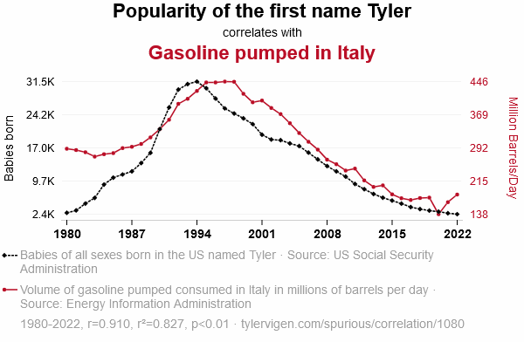

Slide 26
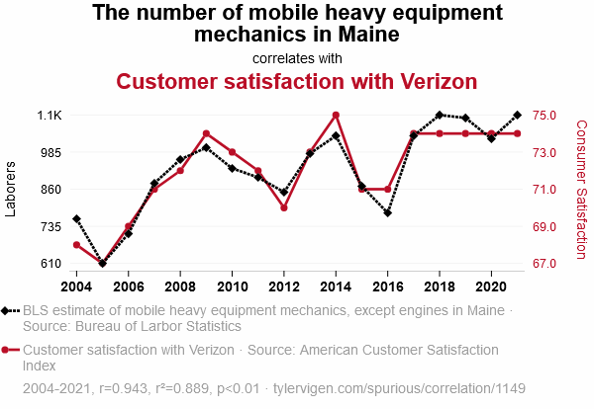

Slide 27
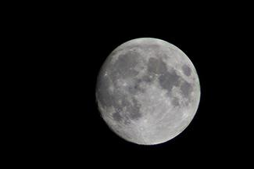
ILLUSORY CORRELATIONS
As well as mistaking correlation for causation, people can also make false correlations.
Illusory Correlations - Seeing relationships between two things when in reality no such relationship exists.
Confirmation bias - tendency to ignore evidence that disproves ideas or beliefs.
Illusory correlations can be involved in the formation of prejudicial attitudes that can lead to discriminatory behavior.
Many people believe that a full moon makes people behave oddly. Research demonstrates that this relationship does not exist.

Slide 28
CAUSALITY: CONDUCTING EXPERIMENTS
& USING THE DATA
The only way to establish that there is a cause-and-effect relationship between two variables is to conduct a scientific experiment.
A scientific experiment has precise requirements for design and implementation.
THE EXPERIMENTAL HYPOTHESIS
Hypotheses can be formulated through:
Observation
After review of previous research

Slide 29
DESIGNING AN EXPERIMENT
EXPERIMENTAL AND CONTROL GROUPS
Experimental group - The participants that experience the manipulated variable (group designed to answer the research question).
Control group - Participants that do not experience the manipulated variable.
Serve as a basis for comparison and controls for chance factors that might influence the results of the study
Experimental manipulation is the only difference between the experimental and control groups, so any differences between the two are due to experimental manipulation rather than chance.
DEFINING VARIABLES AND HOW THEY WILL BE MEASURED
Operational definition - description of what actions and operations will be used to measure the dependent variables and manipulate the independent variables.

Slide 30
INDEPENDENT AND DEPENDENT VARIABLES
Independent Variable – Variable that is influenced/controlled by the experimenter. Ideally this should be the only important difference between the experimental and control group.
Dependent Variable – Variable that the researcher measures to see how much effect the independent variable had.

Slide 31
Experiment Example
THEORY: Social media use is a way of reducing loneliness

Slide 32
Experiment Example
THEORY: Social media use is a way of reducing loneliness
HYPOTHESIS: People will use Facebook more (# minutes use) when they report higher loneliness over the course of a day

Slide 33
Experiment Example
THEORY: Social media use is a way of reducing loneliness
HYPOTHESIS: People will use Facebook more (# minutes use) when they report higher loneliness over the course of a day
Test: Show data that higher loneliness predicts more average Facebook use.

Slide 34
Experiment Example
THEORY: Social media use is a way of reducing loneliness
HYPOTHESIS: People will use Facebook more (# minutes use) when they report higher loneliness over the course of a day
TEST: Show data that higher loneliness predicts more average Facebook use.
Is our theory correct?
  Maybe? Requires further investigation with more samples, other operationalizations, etc.

Slide 35
Avoiding Bias
Experimenter bias - researcher expectations skew the results of the study.
Participant bias – participant expectations skew the results of the study.
Single-blind study - experiment in which the researcher knows which participants are in the experimental group and which are in the control group but participants do not. (Controls for participant expectations).
Double-blind Study - experiment in which both the researchers and the participants are blind to group assignments. (Controls for both participant and experimenter expectations).

Slide 36
The Placebo Effect
Placebo effect - people’s expectations or beliefs influencing or determining their experience in a given situation.
When people are given a pill to improve their mood their mood may increase just because they believe it will.
To know if a medication is really having an effect or whether it us a placebo effect, the experimental group receive the medication and the control group receive a placebo treatment (a sugar pill). This is a double-blind study.
Any differences between the groups will be due to the medication.

Slide 37
SELECTING PARTICIPANTS
Participants – Subjects of psychological research.
  Populations are too large for a researcher to include everyone so samples are used.
Sample - subset of individuals selected from the larger population.
Population – overall group of individuals that the researcher is interested in (e.g. College students).
Random Sample - subset of a larger population in which every member of the population has an equal chance of being selected.
Why is this important?

Slide 38

ASSIGNING PARTICIPANTS TO GROUPS:
EXPERIMENTAL OR CONTROL
Random Assignment – Method of experimental group assignment in which all participants have an equal chance of being assigned to either group.
Can be achieved using statistical software or by simply flipping a coin.
Prevents systematic differences between groups such as gender or age.
Without random assignment, any relationship could be due to preexisting differences between the groups.
Random assignment helps to avoid preexisting systematic differences so that any significant differences between groups can be said to be the result of the manipulation.

Slide 39
ISSUES TO CONSIDER (1)
MANIPULATING VARIABLES
As stated, random assignment is required to state causation. Once randomly assigned, each group is then manipulated in some way. However, some experimental designs are more complicated.
Example: The effect of sex (male/female) on spatial memory.
Sex (independent variable) cannot be manipulated.
Males and females cannot be randomly assigned.
This kind of an experiment is therefore called quasi-experimental.
A cause-and-effect relationship cannot be determined from this type of experiment.

Slide 40
ISSUES TO CONSIDER (2)
ETHICS
Some questions cannot be answered using an experimental design because they would be unethical.
Example: The effect of experiencing abuse as a child on levels of self-esteem.
You cannot randomly assign participants to receive abuse.
This would need to be studied using other approaches such as case studies or surveys.

Slide 41
RELIABILITY AND VALIDITY
Reliability - consistency and reproducibility of a given result.
Would the same test give the same results every time?
Do the instruments/tools used to collect data do so in consistent, reproducible ways?
When a study involves observations by multiple people, it is important that they all make observations and record them in the same way.
Validity - accuracy of a given result in measuring what it is designed to measure.
Does a test measure what it is meant to measure?
A valid measure is always reliable but a reliable measure is not always valid.

Slide 42
BAD SCIENCE & RETRACTION: THE VACCINE-AUTISM MYTH
Many peer-reviewed publications published research making claims that routine childhood vaccines cause some children to develop autism.
Since these reports, large-scale research was carried out suggesting that vaccinations are not responsible for causing autism.
Many of the original studies have since been retracted.
It was found that the leading research in the original study had a financial interest in establishing a link between childhood vaccines and autism.
Unfortunately the initial claims were publicized and many people still think vaccinations cause autism.

Slide 43
ETHICS:
RESEARCH INVOLVING HUMAN PARTICIPANTS
Research involving human participants must adhere to strict guidelines.
Institutional Review Board (IRB) – Committee of administrators, scientists, and community members that reviews proposals for research involving human participants.
Exist at any research institution that receives federal support for research involving human participants.
Generally, IRB must approve research proposal before it can proceed.
Informed consent - process of informing a research participant about what to expect during an experiment and then obtaining the person’s consent to participate. Includes:
Potential risks involved
Implications of the research
Notification that participation is voluntary
Notification that any data collected will be kept confidential

Slide 44
Ethical Issues in Social Research
Anonymity and Confidentiality
  Not the same thing!
Anonymity – Neither the researchers nor the readers of the findings can identify a given response with a given respondent.
Confidentiality – Researcher can identify a given person’s responses but promises not to do so publicly.

Slide 45

Watson and “Little Albert”

Slide 46


Slide 47


Slide 48

The Stanford Prison Experiment (1971)
Simulated a prison environment
  Individuals randomly selected to be “guards” or “prisoners”
  Given uniforms, fully thrown into roles
  “Guards” engaged in all sorts of psychological abuse towards “prisoners”

Slide 49
The Stanford Prison Experiment (1971)
Considered one of the most unethical psych experiments ever conducted
Experiment only lasted 6 days (planned to last two weeks)

Slide 50
National Research Act (1974)
Established regulations designed to protect human participants in research.
Created institutional review boards (IRBs) to ensure that the welfare of participants is adequately protected

Slide 51
Some Questions on Ethics
Does being a participant in a scientific study distort real-life behavior? Do you think people behave differently in an experimental setting vs. everyday life?
What if the only way to collect valid information requires putting participants at risk?

Slide 52
DECEPTION (1)
Deception – Purposely misleading experiment participants in order to maintain the integrity of the experiment.
Is it ethical to deceive participants?
Debriefing - when an experiment involved deception, participants are told complete and truthful information about the experiment at its conclusion.

Slide 53
DECEPTION (2)
The Tuskegee Syphilis study
Ethical guidelines have not always existed.
In 1932, participants were recruited in an experiment studying syphilis in black men.
Participants that tested positive were not informed that they had the disease.
Although no cure existed at the beginning of the study, a cure was found in 1947 (penicillin), but it was not administered to participants.
Many participants unknowingly spread the disease and many died.
https://www.cdc.gov/tuskegee/timeline.htm

